Slide 1
Software group Project –IV Stress Index Calculation Of different countries - research Guided By: Asst. Professor Ms. Nishat shaikh Subject :-Data Analytics and Data Visualization Name: Neel Hetalkumar Shah ID: 18IT124 Btech (I.T) – CSPIT, CHARUSAT
Let’s see Data

Slide 2
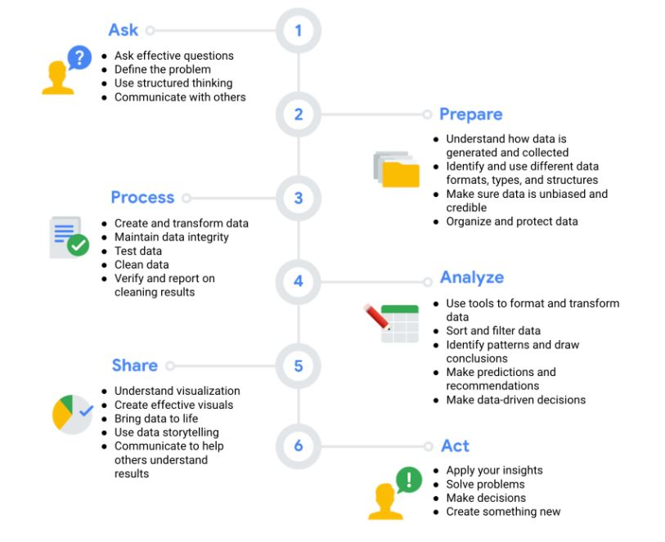
There are six phases of data analysis

Slide 3
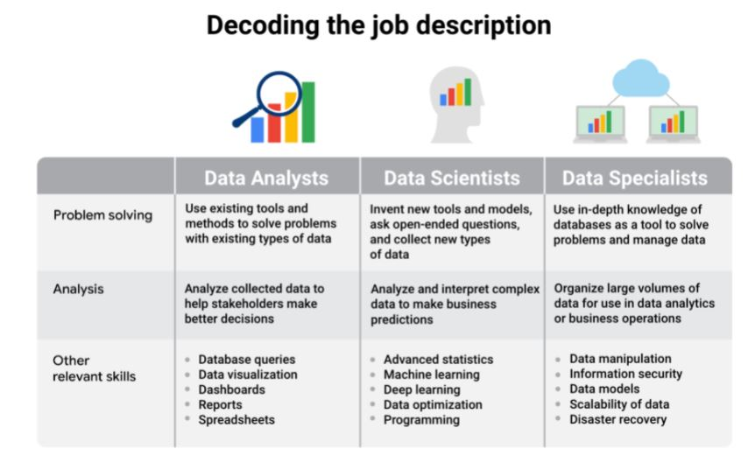
What is Data?
Data is processed or generated information.
It is present everywhere
On an average a human body generates 1.5 Gb of data everyday
Roles of handling data:

Slide 4
Microsoft Power BI Vs Tableau
Power BI is a collection of software services, apps, and connectors that work together to turn your unrelated sources of data into coherent, visually immersive, and interactive insights. Your data may be an Excel spreadsheet, or a collection of cloud-based and on-premises hybrid data warehouses.
Tableau is a powerful and fastest growing data visualization tool used in the Business Intelligence Industry. It helps in simplifying raw data in a very easily understandable format. Data analysis is very fast with Tableau tool and the visualizations created are in the form of dashboards and worksheets.

Slide 5
My work: determining stress levels of different countries based on multiple parameters.
When it comes to stress levels of a nation, It depends on multiple parameters.
Financial stress
Social stress
Emotional stress
Physical stress
Peer stress
Work stress
I have used some datasets from sources like:
Kaggle
Nasa stats
Data.world
Etc.
To determine, compare and visualize some parameters on Power BI
Learning Source:
Coursera

Slide 6
Future scope
My Research paper topic in Multiple Heterogeneous data and visualizing it using different tools like power BI and Tableau has been inspired from United Nations (UN) https://www.un.org/en/
This can help non governmental organizations to act according to the stress state of the locations. This will help profitable institutes to manufacture, process and retail according to the demand and supply of the place.

Slide 7
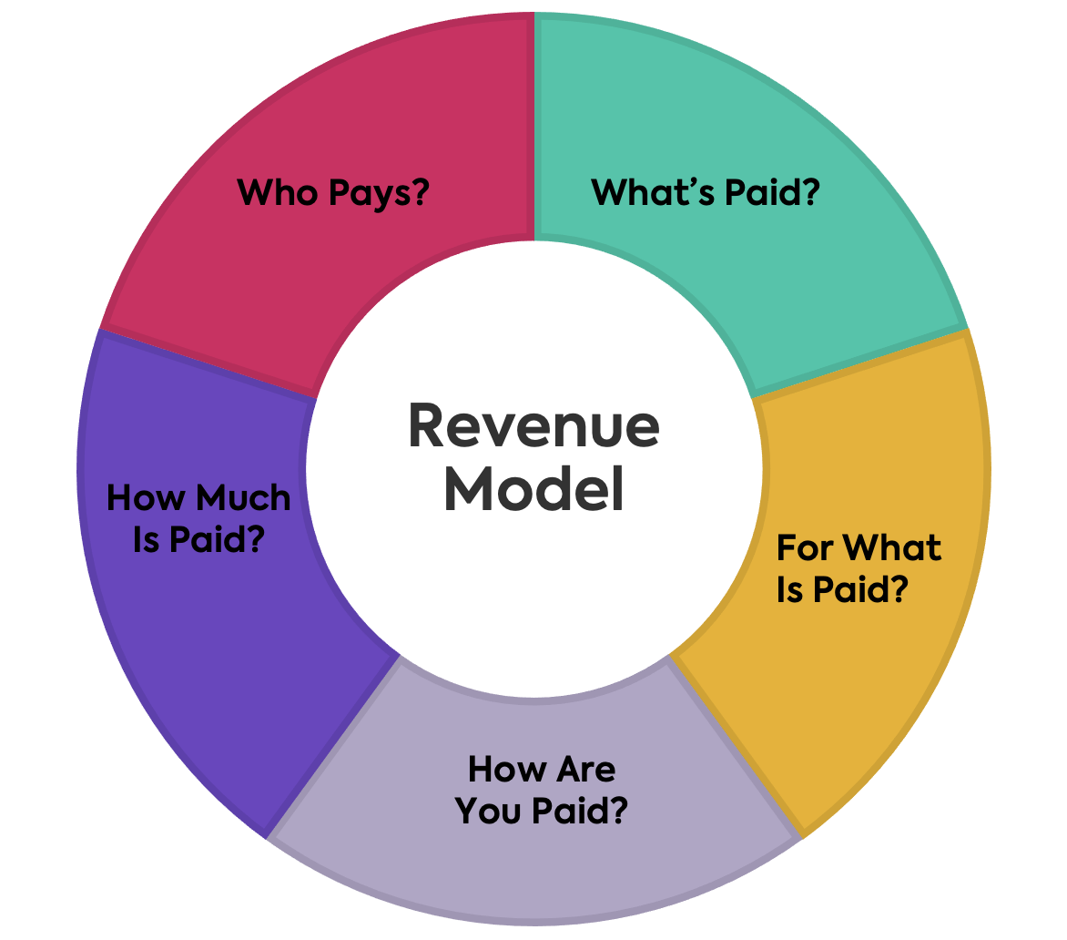
Revenue Model
What’s Paid?
Data:
Data from private organizations or institutes sell data to third party organizations.
Eg: IT companies, Hospitals, Agro Industries, etc…
Data from Govt. and Non- Govt organizations can be acquired for free partially.
Eg: RBI, SEBI, NSDL, NDC, HelpAgeIndia, Redcross Society, UNESCO, World Bank, IMF, etc…

Slide 8
For what is paid?
The data extracted from licensed or private institutes or organizations demands hefty amount of Money.
This can be paid By Financial Transactions, either ways it can be paid by an agreement on data exchange or it is paid by exchange of products or services.
Eg: Cambridge analytica, Foxconn – Famous Electronics contract manufacturer,
Acxiom : Georgia based Big data Broker Company
Equifax, Corelogic, etc.

Slide 9
Who pays and how much?
In the last 2 years, 90% of the world’s data has been created and businesses are spending more than $180 billion a year on big data analysis
The term Big Data has been around for some time now, but it has taken a whole new meaning today when people share 500 terabytes of data per day just on Facebook. And on YouTube, there are over 300 hours of video shared every minute!
The email address of a single internet user is worth $89 to any brand
If the collective revenue of digital advertising companies in the US is put together, the data generated from an adult would be worth about $35 per month. According to “pawtocol”
Pawtocol is a global online community of pet lovers who are disrupting the pet industry by leveraging block chain technology while monetizing data about their pets. Data is aggregated from IOT devices like our Block chain Pet Tag

Slide 10
Factors affecting value of data
Another great way to estimate the worth of a user data is to calculate the amount in cash equivalent after an acquisition. Microsoft, for instance, acquired LinkedIn for a $26.2 billion cash deal. At the time of the acquisition, the professional business-oriented site had a membership count of over 400 million users.
Going with this information, it is safe to say that a single user data point was valued at an estimated $65 per user in the purchase.
Following this logic, a popular social media giant, Facebook acquired WhatsApp for $19.6 billion. That means Facebook paid $39.6 for each of WhatsApp’s 500 million users. The value of user data could vary but depends heavily on the earning potential expected from each user.

Slide 11

Let’s see how
Just like Amazon, Starwood hotels (one of the brands under Marriott hotels) also use dynamic pricing. It is changing based on a variety of factors such as local and global economic situation, weather, availability and reservation behavior, cancellations and many others – this tactic resulted in a 5% revenue increase per room.
They go so deep with utilizing data that they even follow if famous musicians are playing at the Madison Square Garden so they could adjust their rates at their nearby hotels.
To create a better customer experience, they also started testing out facial recognition check-ins which looks like a win-win scenario – their guests don’t need to wait at the reception desk anymore, and the hotel gathers even more valuable information. Another element they implemented to gather data is putting Amazon Echos into the rooms – this allows guests to make Alexa handle everything that was previously handled by the reception staff. Now guests can get all the information they want, while Marriott gets the knowledge of their customer’s preferences, needs and potential concerns.

Slide 12
Recent
BRITISH AIRWAYS: “Know Me” program combines already existing loyalty information with the data collected from customers based on their online behavior. With the blending of these two sources of information, British Airways can make more targeted offers while responding to service lapses in ways to create a more positive experience for the flyer.
AMERICAN EXPRESS: Starts looking for indicators that could predict loyalty and developed sophisticated predictive models to analyze historical transactions and 115 variables to forecast potential churn. The company believes it can now identify 24% of accounts that will close within the next four months.
EBAY: “the Feed” is a new homepage that allows customers to follow entire categories of items no matter how obscure. This makes it easier for customers to stay on top of the latest items they have a particular interest, especially if they are collectors.
GOOGLE: Working with the U.S. Centers for Disease Control, tracks when users are inputting search terms related to flu topics, to help predict which regions may experience outbreaks.

Slide 13
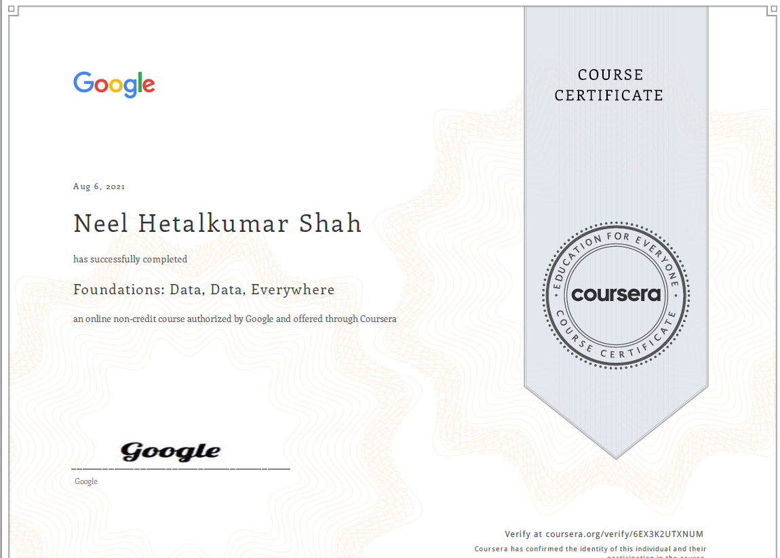
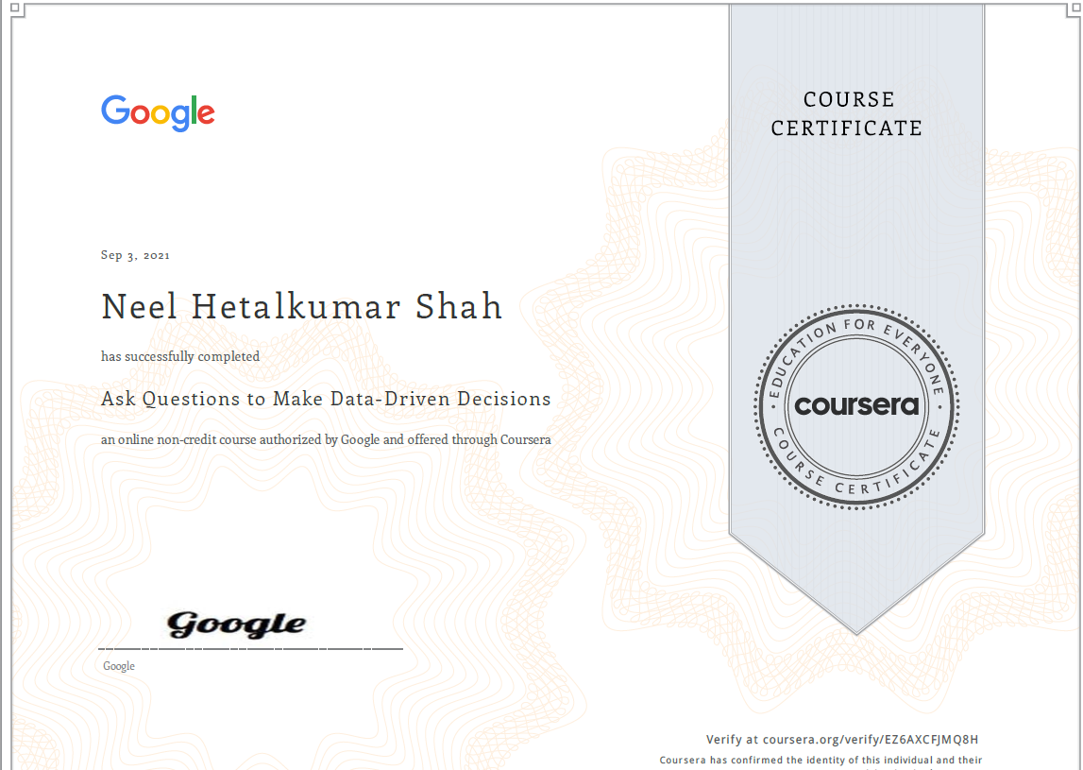
Thank You!
Github Link: https://github.com/neelshah124/SGP-IV-Power-BI-data/tree/main
Learning outcome

